Slide 1




Module - 4
Version Controlling and Hosting

Slide 2

DISCLAIMER
The content is curated from online/offline resources and used for educational purpose only

Slide 3

Learning Objective
You will learn in this Chapter:
Apply modern web development skills using AI-assisted tools like GitHub Copilot and Cursor AI.
Enable rapid prototyping and data visualization through Streamlit for building interactive web applications.
Introduce AI integration techniques using tools like Gemini API for smart feature development (e.g., chatbots, content generation).
Develop proficiency in version control and cloud deployment using Git, GitHub, and Streamlit Community Cloud.
Empower learner to transfer industry-relevant skills to students, enhancing employability and innovation in academic projects.

Slide 4

Learning Outcome
You will learn in this Chapter:
Understand what Git and Github is?
Explain the key features and differences between Git and GitHub.
Create a GitHub account and navigate its features such as repositories, dashboards, and profile settings.
Organize and structure files appropriately for Streamlit Community Cloud applications.
Sign up for and configure Streamlit Community Cloud using GitHub or other authentication methods.
Connect a GitHub repository to Streamlit Community Cloud and deploy a Streamlit application.
Demonstrate the complete workflow of building, versioning, hosting, and deploying simple web applications using GitHub and Streamlit.

Slide 5
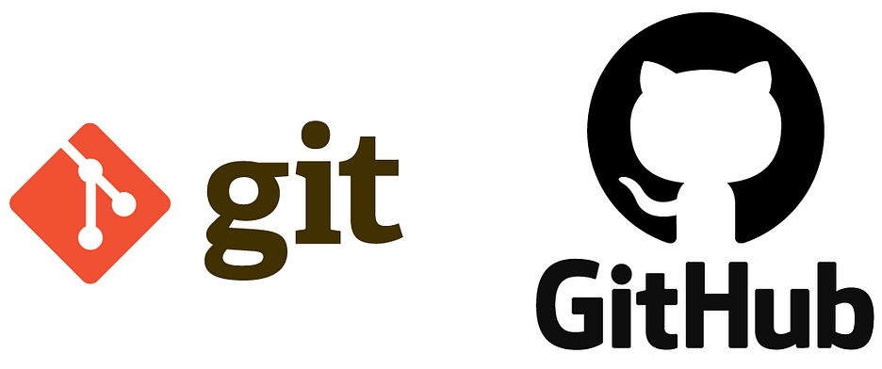
Introduction to GitHub
Introduction
Version control helps track and manage changes in files over time.
Git is a distributed version control system used to manage project history.
GitHub is a cloud-based platform built around Git for storing and sharing repositories.
It enables collaborative work by allowing multiple contributors to work on the same project.
Changes are tracked, reviewed, and merged systematically using branches and pull requests.
It improves transparency, teamwork, and organized development.
Source :
https://miro.medium.com/v2/resize:fit:1200/1*mtsk3fQ_BRemFidhkel3dA.png
Notes:
Version control is a method that allows developers to record changes made to files so that they can go back to previous versions if needed. It is similar to maintaining a detailed record of how a document or a code file changes over time. This concept is very important when working on software projects that involve many files and frequent updates.
Git is a tool that provides distributed version control. This means that every developer has a complete copy of the project history on their own computer. Developers can make changes locally and later synchronize these changes with a central repository. This way, even if there is a problem with the network or central server, the project history is safe on individual systems.
GitHub is a platform built on top of Git. It provides an online space where repositories can be stored and shared. It acts like a library of projects where developers can upload their code, and other developers can access it. GitHub is not Git, but it uses Git in the background to manage version control.
Collaboration is one of the most important features of GitHub. Multiple contributors can work on the same project at the same time without interfering with each other's work. Developers create separate branches for their changes. These branches can later be reviewed and merged with the main branch through a process known as a pull request.
These features of GitHub make it a preferred choice for teams working on programming projects, technical reports, research documentation, and other large documents that need controlled contributions from many people.

Slide 6

Introduction to GitHub
Definition of Git
Git is a distributed version control system that tracks changes in files.
Every developer has a complete local copy of the repository with full history.
Git allows tracking changes, collaboration, branching, merging, and ensures data integrity.
Git can be used for software projects as well as documentation and datasets.
Source :
https://miro.medium.com/v2/resize:fit:1200/1*mtsk3fQ_BRemFidhkel3dA.png
Notes:
Git is a tool used to manage changes to files over time. It is called a distributed version control system because every contributor to a project has a full copy of the repository on their own machine. This includes all the files and the entire history of changes made to the project. As a result, even if there is no network connection, work can continue locally. Once the connection is available, these changes can be shared with others.
The main goals of Git are to record every change made to the files, allow multiple people to work together, and make it easy to combine their work without conflicts. Developers can go back to earlier versions if something goes wrong. It is designed to be fast and ensures that all stored information is secure. One of its strengths is the ability to create branches. A branch is like a separate line of work where a new feature or idea can be tried out without affecting the main project. For example, when a group of faculty members prepare lecture notes, each person can prepare a separate section in their own branch. After completing their part, they can combine their work with the main document.
Git is not limited to programming. It can also be used for version control of other work such as research papers, presentations, and datasets.

Slide 7

Introduction to GitHub
Definition of GitHub
GitHub is a cloud-based platform built on Git for hosting and managing repositories.
GitHub provides collaboration tools, pull requests, reviews, and issue tracking.
GitHub enables remote hosting, project management, and integration with automation tools.
GitHub adds security, backup, and a space for community contributions.
Source :
https://miro.medium.com/v2/resize:fit:1200/1*mtsk3fQ_BRemFidhkel3dA.png
Notes:
GitHub is a platform that uses Git as its foundation but provides a web-based environment where these repositories can be stored in a central place. It acts as a shared online space where all contributors can upload their changes and access each other’s work.
Some key features of GitHub include hosting of repositories on a remote server, making it possible for team members in different locations to collaborate. GitHub offers tools such as pull requests, which are a way to propose changes. Other members can review these changes, discuss them, and approve them before adding them to the main project. This process improves the quality of work because there is a clear review step.
GitHub also supports project management by providing tools such as boards and issues that can be used to track tasks and progress. For example, in a faculty project where a group is creating a curriculum, they can create issues for each chapter and assign them to different members.
Another important feature is integration with automation tools that test or deploy the code. This ensures that projects can be checked automatically before they are shared.
Security and backup are additional benefits. Because the repository is stored on a remote server, there is an extra copy available in case of any data loss on a local machine. GitHub also includes features to scan for potential security problems in code.

Slide 8
Introduction to GitHub
Comparison Table
Aspect | Git | GitHub
Type | Distributed version control system | Web-based hosting platform built on top of Git
Functionality | Tracks and manages changes to files locally and in distributed setups | Provides cloud storage for repositories with additional collaboration features
Connectivity | Can work completely offline | Requires internet access for hosting, syncing, and collaboration
Scope | Focuses on version control and branching | Adds features like pull requests, code reviews, issue tracking, and project boards
Usage | Used from the command line or GUI clients | Accessed through a web interface and integrations
Ownership | Free and open-source software maintained by the community | Commercial platform (offers free and paid plans)
Primary Role | Version control and code history management | Centralized repository hosting and collaboration environment
Notes:
This table explains the difference between Git and GitHub. Both are related to version control but they are not the same.
Git is a distributed version control system. It is a tool that runs on a computer and keeps a complete copy of the project along with its entire history of changes. Because of this distributed approach, it can work completely offline. For example, if a developer is travelling and does not have an internet connection, they can still make changes, record them, and view previous versions on their computer.
GitHub, on the other hand, is a platform built on top of Git. It is a web-based service that provides a central place to store Git repositories. Unlike Git, GitHub needs internet access because it is designed for sharing, syncing, and collaborating on projects. Developers upload their work to GitHub so that others can access it.
In terms of usage, Git is used directly from the command line or from a graphical interface that runs on the local machine. Commands like commit, branch, and merge are performed through Git. GitHub is accessed through a web browser. It provides additional tools like pull requests, reviews, and issue tracking to manage the collaborative work.
The primary role of Git is to track file changes and maintain a history of those changes. It ensures that every version is stored safely on the local machine.
GitHub plays a different role. It provides a shared and centralized environment where teams can collaborate, store their code securely, and work together more effectively.

Slide 9
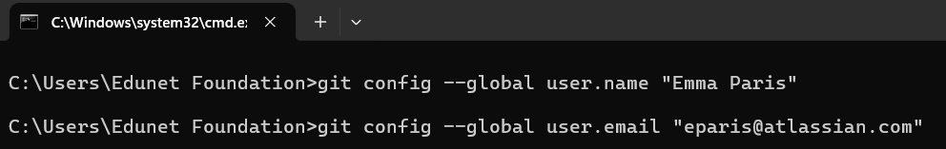
Introduction to GitHub
Install Git on Windows
Download Git for Windows installer from the official website.
Run the installer and follow the steps in the setup wizard.
Use the default options during installation.
Open Command Prompt or Git Bash after installation.
Configure Git username and email using commands.
Username and email are linked to your commits.
Notes:
Before using Git or GitHub, it is necessary to install Git on your computer. Git for Windows is available as a stand-alone installer on the official website. After downloading, you need to start the installer. It will open a setup wizard that guides you through the installation process. For most users, the default settings are suitable and do not need to be changed. Once you click on Next for each step and then Finish, the installation will be complete.
After Git is installed, you can use it either from the Command Prompt or from a separate application called Git Bash. Git Bash provides a Linux-like environment for those who prefer it. If you choose to use the Windows Command Prompt during installation, you can run Git commands directly from there.
The next step is to configure your personal details. These details include your name and email address. These details are important because they are stored with every change you make in a repository. This helps in identifying who made a change and when. For example, in a project where several faculty members are working on a set of lecture notes, the commit history shows which person added or corrected a specific section.
You can set these details using the following commands. Replace the example name and email with your own.
git config --global user.name "Your Name“
git config --global user.email "yourname@example.com"
The --global option means that these details will be applied to all repositories on your computer. If you do not set them globally, Git may ask for these details each time you make a commit.
This setup process is an important first step before starting to create repositories, track file changes, or collaborate using Git and GitHub. It ensures that your contributions are properly attributed to you in any project history.

Slide 10
Introduction to GitHub
Account Creation
Open the GitHub Website
Start the Sign-Up Process
Enter Your Email Address
Create a Password
Choose a Username
Access Your GitHub Dashboard
Choose Your Plan
Verify Your Email Address
Verify You Are Not a Robot
Notes:
To use GitHub, the first step is to create an account. Open any web browser and type the GitHub website address. This will take you to the home page.
On the top right corner of the page there is a “Sign up” button. Clicking this button will begin the account creation process.
The system will ask for your email address. It is important to provide an email address that you can access because this email will be used for verification and for communication about your account. After entering the email, click on “Continue”.
The next step is to create a password. A strong password helps keep your account secure. A good password includes a mix of uppercase letters, lowercase letters, numbers, and symbols. After entering the password, continue to the next step.
Now you need to select a username. This username must be unique because it will be the name by which other people will see you on GitHub. If the name you want is already in use, the system will ask you to choose another one or suggest alternatives.
Next, you will need to complete a captcha verification. This step confirms that the account is being created by a person and not by an automated system.
After completing these steps, GitHub will send a verification code to the email address you entered. Go to your email inbox, find the mail from GitHub, and copy the code. Paste this code into the verification box on the GitHub page to confirm your email.
Once your email is verified, GitHub will ask you to select a plan. For beginners, the free plan is more than enough. It allows you to create unlimited public and private repositories. Paid plans are available later if you need additional features. Choose the free plan and continue.
When all these steps are completed, your account will be ready. You will be directed to the GitHub dashboard. This dashboard is the home page of your account and from here you can create a new repository, explore projects shared by other people, or edit your profile details.

Slide 11
Introduction to GitHub
Creating Repositories
Click on “New repository” from the top-right corner.
Select visibility: public or private.
Sign in to your GitHub account.
Click “Create repository” to complete.
Review email settings to protect your email address.
Enter a short and memorable repository name.
Select “Initialize this repository with a README”.
Notes:
A repository on GitHub is a storage space where all project files and their revision history are kept.
Before creating a repository, it is necessary to have a GitHub account. If you do not have one, visit the GitHub website and complete the sign-up process by entering your email and other required details.
After signing in, it is a good practice to review the email settings on GitHub. These settings allow you to keep your email address private. When these options are enabled, your email address will not appear publicly in your commits or in your profile. This is useful for privacy, especially when collaborating on projects with many contributors.
To create a repository, go to the top-right corner of the GitHub page and select the “New repository” option. A form will appear asking for details about your repository. First, you need to give your repository a short and meaningful name. For example, if you are creating a project to store teaching material for a programming course, you can name it “programming-material”.
You can also write a short description to explain the purpose of the repository. For example, “Repository for lecture notes and assignments for the programming course.” This description helps others understand the content of the repository.
Next, you need to select the visibility of your repository. Public repositories can be seen by anyone, while private repositories are visible only to you and the people you invite. For internal projects such as developing course material within a team, a private repository is usually preferred.
The next step is to initialize the repository with a README file. A README file is a simple text file that describes the repository. It acts as an introduction to the project and is helpful for people visiting the repository to know what it is about.
Finally, click on “Create repository”. After this step, your repository is ready. From here, you can add files, create folders, and make changes.

Slide 12
Introduction to GitHub
Commit Change
Open your repository and select the README.md file.
Click on the edit option in the upper right corner.
Add or update content in the file and review changes.
Use “Preview” or “Show diff” to check modifications.
Write a short and meaningful commit message.
Choose whether to commit to the current branch or create a new branch.
Click “Commit changes” or “Propose changes” to save.
Notes:
In Git and GitHub, a commit represents a snapshot of your work. Think of it as taking a photograph of all the files in your project at a specific point in time. Every commit records exactly what was changed, when it was changed, and who made the change.
When you first created a new repository, you chose to initialize it with a README file. The README file is very important because it describes the purpose of the repository. It can also include instructions on how to use the files or how to set up the project. The content of this README file is automatically displayed on the repository’s main page, making it the first thing others see when they visit your repository.
To commit a change, open the repository on GitHub and select the README.md file from the list of files. This opens a page showing the file content. On the top right of the file view, there is an option to edit the file. Clicking this option will open an editor where you can make your changes.
Type in the new content you want to add. For example, you may want to add a brief description about yourself, a note on what the repository will be used for, or instructions for others who want to use the content.
Once you have made the changes, click on “Preview” to see how the file will look after the change. There is also an option called “Show diff”. This feature highlights the changes made, with new content shown in green. This helps you to confirm that only the intended parts were changed.
The next step is to write a commit message. A commit message is a short description of what you have changed. For example, if you added a description about the project, your commit message could be “Added project description to README file.”
Below the commit message area, there is an option to choose where to apply the commit. If you are working on the main branch of the repository, it is often better to create a new branch. This allows you to make changes safely and later combine them using a pull request. If you are already working on a separate branch, you can commit directly to that branch.
Finally, click on “Commit changes” if you are working on the current branch or “Propose changes” if you are using a new branch. This step will save your work in the repository as a new version.

Slide 13
Introduction to GitHub
Creating Personal Access Tokens (PAT)
Generate a Personal Access Token (PAT) in GitHub settings.
Go to Developer settings then Personal access tokens then Tokens (classic).
Click “Generate new token (classic)” and select the scope “repo”.
Verify and copy the correct remote HTTPS URL from your repository.
Use GitHub username and token instead of password when prompted.
Generate the token and copy it for later use.
Notes:
When you commit changes from your local machine to GitHub using the command line, GitHub no longer allows the use of regular passwords for authentication. Instead, a Personal Access Token, commonly called PAT, is required. A PAT is like a special key that allows secure communication between your computer and GitHub.
To create a PAT, open your GitHub account in a browser. Click on your profile menu at the top right and go to Settings. From there, select Developer settings and then choose Personal access tokens.
Inside this section, open “Tokens (classic)” and click on “Generate new token (classic)”. While creating the token, GitHub asks what permissions or scopes you want to give the token. For normal repository operations such as pushing or pulling changes, you should select the scope “repo”. This gives full access to both public and private repositories from your computer.
Once the options are selected, click “Generate token”. GitHub will now display your token. It is important to copy this token and store it safely because it will not be displayed again.
Once the token is generated, whenever you push changes from your local machine to GitHub using the command line, Git will ask for your username and password. In this case, you will provide your GitHub username as the username and paste the Personal Access Token in place of the password. This ensures that the communication is secure and properly authorized.
Before pushing changes, confirm that the correct remote repository URL is set. To find this, open your repository on GitHub and click on the green “Code” button. You will see an HTTPS URL that looks like “https://github.com/username/repositoryname”. Copy this URL and use it when setting the remote for your local repository.

Slide 14
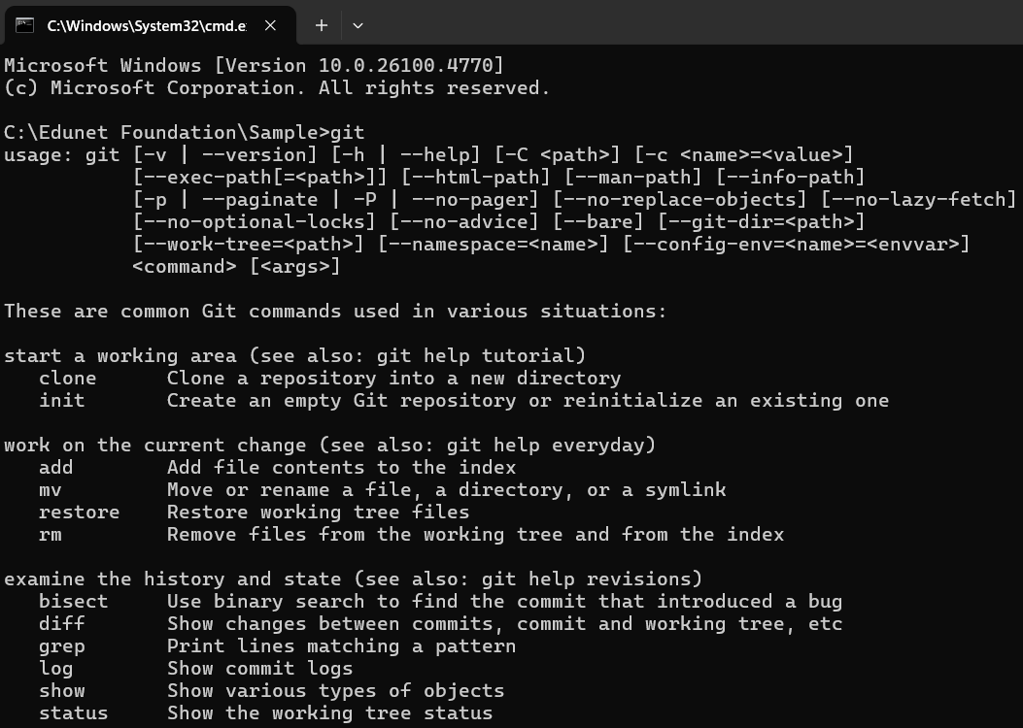
Introduction to GitHub
Commands
git
git is the main command-line tool for interacting with Git.
It is used with subcommands (like init, add, commit, push) to manage your repository.
Just typing git shows you a list of common Git commands.

Slide 15
Introduction to GitHub
Commands
git init
git init creates a new empty Git repository in the current folder.
After this, Git will start tracking changes in that folder.

Slide 16
Introduction to GitHub
Commands
git add
git add tells Git to stage files (mark them for the next commit).
You can add a single file, multiple files, or all files in the folder.
Make sure to have the file with the same name present within the folder.

Slide 17
Introduction to GitHub
Commands
git add
git add tells Git to stage files (mark them for the next commit).
You can add a single file, multiple files, or all files in the folder.
Make sure to have the file with the same name present within the folder.
git add .
To add all the files present in the folder

Slide 18
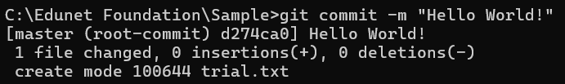
Introduction to GitHub
Commands
git commit
git commit saves your staged changes into the repository with a message describing the changes.
This creates a version (snapshot) of your code.

Slide 19
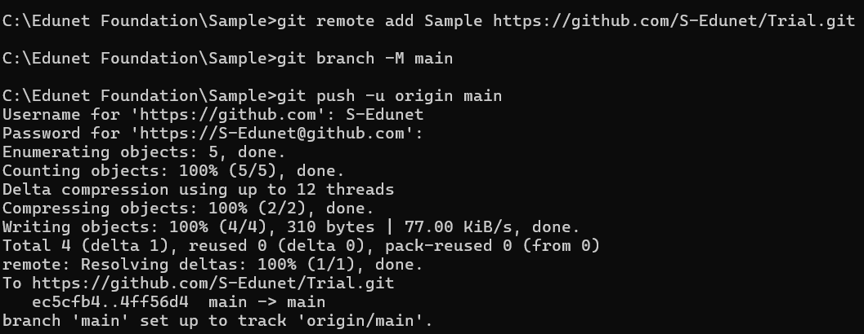
Introduction to GitHub
Commands
git push
git push uploads your commits to a remote repository (like GitHub).
Before you can push, you need to have:
A remote repository (for example, on GitHub)
Added the remote using git remote add Sample <URL>
Pulled/pushed once to set the upstream branch (if first time)
Commands:

Slide 20
Streamlit Community Cloud
Creating Account on Streamlit Community Cloud
Open a web browser and visit https://streamlit.io/cloud or https://share.streamlit.io/.
Click on “Sign up” if you are visiting for the first time.
Choose a sign-up method: GitHub, Google, or Email/Password.
Authorize Streamlit if using GitHub or Google.
Complete profile setup and confirm email.
Access Streamlit dashboard after verification.
Use the dashboard to deploy new apps or manage existing apps.
Notes:
Streamlit Community Cloud is a platform that allows you to host and share Streamlit applications online.
Before you can use the platform, you need to create an account. Open any web browser and go to the Streamlit Community Cloud website. The website will open a sign-in or sign-up page.
If you are using Streamlit Community Cloud for the first time, click on the “Sign up” button. There are different ways to sign up. You can sign up using your GitHub account, your Google account, or with an email and password combination if that option is available. It is recommended to use a GitHub account because Streamlit directly deploys apps from GitHub repositories.
When you select GitHub as the sign-up option, you will be redirected to GitHub to confirm your login. If you are already signed in to GitHub, it will ask you to authorize Streamlit to access your repositories.
Click on “Authorize Streamlit” to give permission. This step is necessary so that Streamlit can pull your application files from GitHub when you deploy them. Similarly, if you use a Google account, you will be redirected to a Google login page for authorization.
After authorization, you will be asked to complete your profile. This may include confirming your email address, setting a display name, and agreeing to the terms and conditions.
If the platform requires email verification, check your email inbox, open the verification mail sent by Streamlit, and click the verification link to confirm your account.
Once this process is completed, you will be redirected to the Streamlit dashboard. This dashboard is the main workspace where you can deploy new applications by linking a GitHub repository. You can also view, manage, and control access to your deployed applications from this dashboard.

Slide 21
Streamlit Community Cloud
File Organization for Community Cloud App
Create a project folder with a meaningful name.
Add your main Python file (e.g., streamlit_app.py).
Prepare a requirements.txt file listing all libraries.
Add datasets, images, or configuration files in subfolders.
Push the project folder to a GitHub repository.
Ensure main files are in the root of the repository.
Deploy the app from GitHub using Streamlit Community Cloud.
Notes:
To deploy an application on Streamlit Community Cloud, it is very important to organize your project files properly.
The first step is to create a project folder on your computer. Give this folder a short and meaningful name so that you can easily identify it later. This folder will hold all files required for your Streamlit application.
Inside this folder, create your main Python file. This file should be named clearly, for example streamlit_app.py or app.py. Streamlit Community Cloud looks for this file while deploying, so it should be in the root of your project folder. All your Streamlit code, starting with import streamlit as st, should be written in this file.
The next important file is requirements.txt. This file tells Streamlit what Python libraries your application needs. Open a text editor, create a file named requirements.txt, and list the names of all required libraries one per line. For example, if your app uses Streamlit, pandas, and matplotlib, write: streamlit pandas matplotlib. This file must also be in the root folder, at the same level as your main Python file.
If your application uses datasets, images, or configuration files, create additional subfolders such as data or images. Place the required files inside these subfolders to keep your project organized. Avoid keeping extra or unrelated files in the main folder.
You can also use version control for better management. To do this, open a terminal or command prompt in your project folder and initialize a Git repository. After making an initial commit, you can connect this local repository to a GitHub repository. Create a new repository on GitHub, copy its HTTPS link, and use Git commands to push your files. This will make your project available on GitHub.
On GitHub, check that your repository structure is correct. The main Python file and requirements.txt file must be directly visible in the root of the repository. Any datasets or images should be in their respective folders.
Once everything is ready, visit the Streamlit Community Cloud website and log in. From your dashboard, click “New app”. Select the repository where your files are stored, choose the main branch, and select the main Python file. Then click Deploy.

Slide 22

Streamlit Community Cloud
Connect GitHub Account and Deploying App
Sign in to Streamlit Community Cloud.
Click “Deploy” to deploy the app.
After authorization, select repository, branch, and main Python file.
Click on “New app” or “Deploy an app” after logging in.
Authorize Streamlit to connect to GitHub.
Choose to allow Streamlit access to all or selected repositories.
Notes:
Once your Streamlit Community Cloud account is created and your project is ready on GitHub, the next step is to connect GitHub and deploy the application.
Begin by opening a web browser and visiting the Streamlit Community Cloud website. Click on the “Sign in” button and log in using the same method you used during account creation. Most users sign in with GitHub, but even if you signed up using Google, you will have the option to connect your GitHub account during this deployment process.
After signing in, click on the “New app” or “Deploy an app” button. If this is your first time deploying an application, Streamlit will ask you to connect to a GitHub account. Click on “Connect to GitHub”.
You will be redirected to the GitHub login page if you are not already logged in. Enter your GitHub username and password, and then GitHub will display a permissions screen. This screen shows what level of access Streamlit will have.
You can choose to allow Streamlit access to all of your repositories or to specific repositories only. It is recommended to allow access to only the repositories you want to deploy.
After authorizing Streamlit, you will be redirected back to the Streamlit dashboard. Now you will see a dropdown list showing your GitHub repositories. Select the repository that contains your Streamlit project files. Then choose the correct branch, which is usually named “main”, and specify the main Python file such as streamlit_app.py.
Click on the “Deploy” button to start the deployment. Streamlit will now use the code from your GitHub repository to set up the application online. This process might take a few minutes during the first deployment. Once the app is deployed, Streamlit will remember your GitHub connection. For future updates, you simply need to push the updated code to GitHub, and Streamlit will automatically reflect the changes.
It is important to keep your repository up to date with the latest code by using version control commands. When working on multiple branches, always deploy from a stable branch, usually “main”, to avoid errors. For private repositories, ensure that Streamlit has permission to access them.

Slide 23

Lab Activity
Lab 1 - Deploying Web Applications with Streamlit Community Cloud and GitHub

Slide 24
Reference
Atlassian. (n.d.). What is Git | Atlassian Git Tutorial. https://www.atlassian.com/git/tutorials/what-is-git
GeeksforGeeks. (2025, July 16). A Beginners guide to Streamlit. GeeksforGeeks. https://www.geeksforgeeks.org/python/a-beginners-guide-to-streamlit/
Git. (n.d.). https://git-scm.com/
Streamlit • A faster way to build and share data apps. (n.d.). https://streamlit.io/
Wikipedia contributors. (2025, July 24). GitHub. Wikipedia. https://en.wikipedia.org/wiki/GitHub
Working with GitHub in VS Code. (2021, November 3). https://code.visualstudio.com/docs/sourcecontrol/github

Slide 25





Slide 26

Quiz
What does GitHub primarily provide to developers?
Cloud hosting for repositories with collaboration
Local-only history
Text editing offline
AI model training
Answer: A
Cloud hosting for repositories with collaboration

Slide 27
Quiz
GitHub repositories can be described as _____.
Temporary backups deleted daily
Collections of project files and their history
Encrypted password vaults
Spreadsheet macros
Answer: B
Collections of project files and their history

Slide 28
Quiz
To keep your email private on GitHub you should adjust settings on which page?
Security keys
SSH and GPG keys
Billing
Email settings
Answer: D
Email settings

Slide 29
Quiz
The primary role of Git is _____.
Version control and code history management
To track tasks on boards
Provide community networking site
To host repositories remotely
Answer: A
Version control and code history management

Slide 30
Quiz
Which GitHub interface element holds code, branches, and commits for a project?
Community board
Profile settings
Dashboard
Repository
Answer: D
Repository

Slide 31
Thank You

